Slide 1
who is your favorite celebrity? As for me…

Slide 2
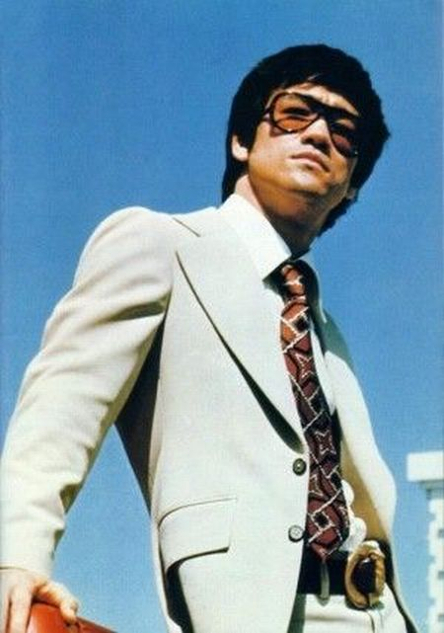
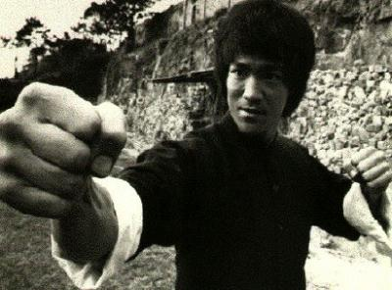
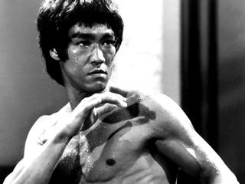
It’s this guy…
Bruce Lee is among the most influential celebrities of the 20th Century.
Bruce Lee!!!!!!!!

Slide 3
What I am going to talk about:
Bruce Lee’s Martial Arts history and Accomplishments.
Bruce Lee’s Acting Career in Chinese and American Movies
Bruce Lee’s Health Regimen and Feats of Athleticism
Bruce Lee’s Philosophical Approach to Martial Arts and Everyday Living

Slide 4
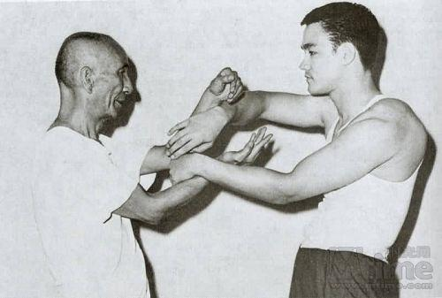
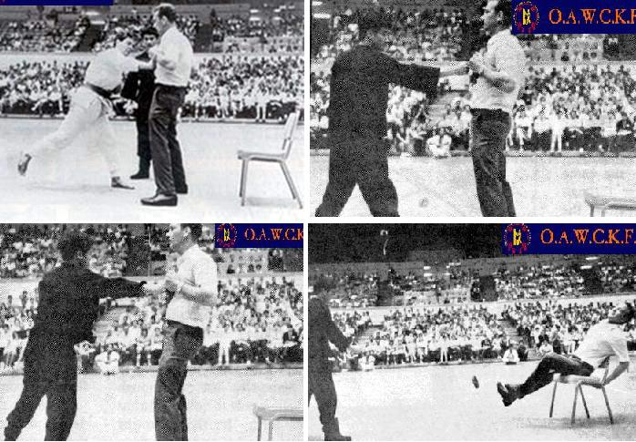
Bruce Lee’s Martial Arts history and Accomplishments.
Give source or sources

Slide 5
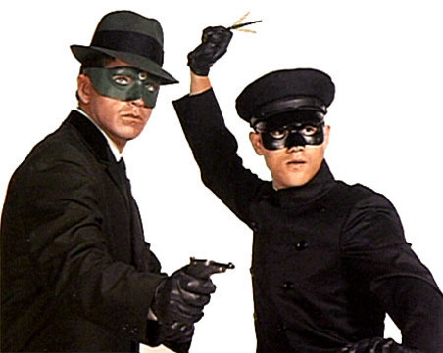
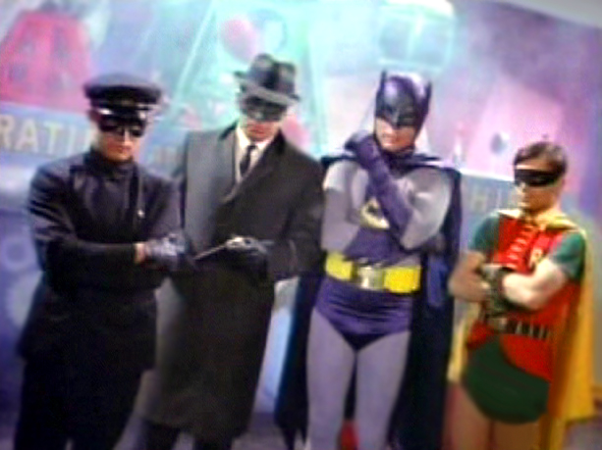
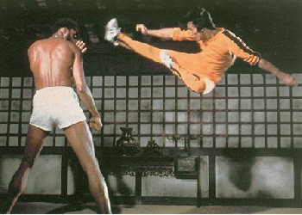
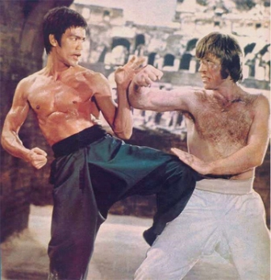
Bruce Lee’s Acting Career in Chinese and American Movies
Give supporting source or sources

Slide 6
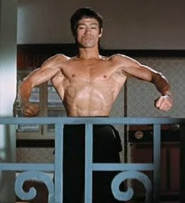
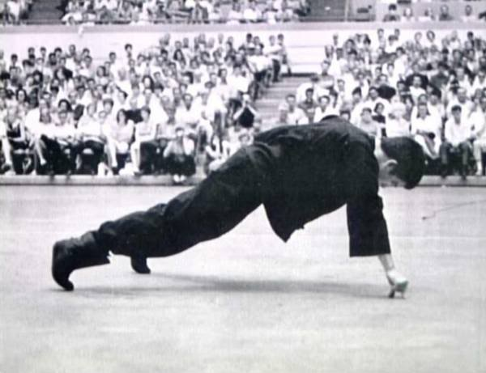
Bruce Lee’s Health Regimen and Feats of Athleticism
Give supporting source or sources

Slide 7
Bruce Lee’s Philosophical Approach to Martial Arts and Everyday Living

Slide 8
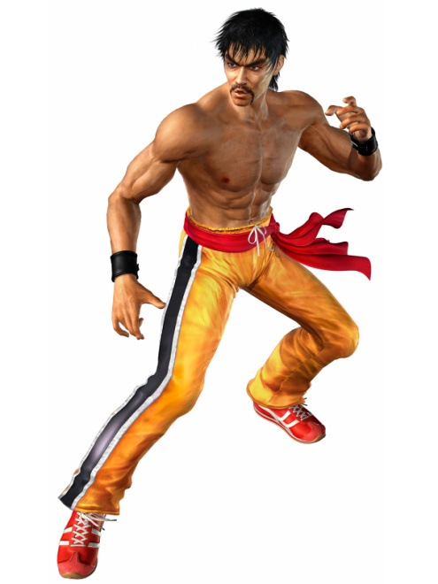
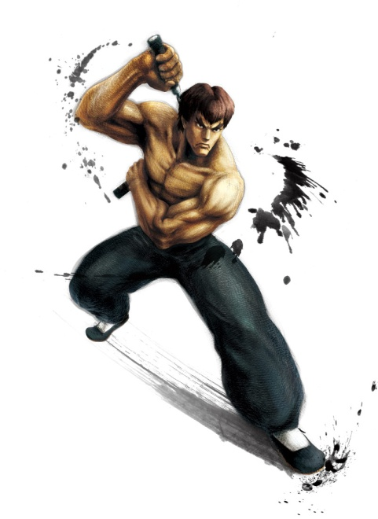
In Conclusion
Whether if it was in acting, fighting, or philosophy, Bruce Lee revolutionized these fields so profoundly that his image is still being used in the media to this date.

Slide 9
As we have seen the facts from:
Bruce Lee’s Martial Arts history and Accomplishments.
Bruce Lee’s Acting Career in Chinese and American Movies
Bruce Lee’s Health Regimen and Feats of Athleticism
Bruce Lee’s Philosophical Approach to Martial Arts and Everyday Living

Slide 10
Sources (you only list the sources you have cited in your discussion slides).
The_Legend_Of_Bruce_Lee. Digital image. Headweb.com. Web. 9 Oct. 2011. <http://sm.headweb.com/factualtv/title_pix/The_Legend_Of_Bruce_Lee.jpg>.
Bruce Lee Fist. Digital image. Antville.org. Web. 9 Oct. 2011. <http://oelie.antville.org/static/oelie/images/bruce lee fist.jpg>.
Rare_photographs_of_celebrities_125. Digital image. Http://izismile.com. Web. 9 Oct. 2011. <http://izismile.com/2010/01/20/rare_photographs_of_celebrities_125_pics.html>.
Bruce_lee_ip_man. Digital image. Blogspot.com. Web. 9 Oct. 2011. <http://3.bp.blogspot.com/_O3mda6XzlL8/TDCC2JA4UkI/AAAAAAAAAXM/olnWY8nEVFs/s1600/bruce_lee_ip_man.jpg>.
JeetKuneDo. Digital image. Wikipedia.org. Web. 9 Oct. 2011. <http://en.wikipedia.org/wiki/File:JeetKuneDo.svg>.
Bruce_lee_10. Digital image. Blogspot.com. Web. 9 Oct. 2011. <http://4.bp.blogspot.com/_ve8LfyD_gmg/S_C6CEqlYmI/AAAAAAAAAvk/8r6hstjKY1k/s1600/bruce_lee_10.jpg>.
Green-hornet-tv. Digital image. Blogspot.com. Web. 9 Oct. 2011. <http://2.bp.blogspot.com/_QqvfSFxx5rI/TS9_H2mbZLI/AAAAAAAAZdo/B05P0IpcLq4/s1600/green-hornet-tv.jpg>.
Batman_green_hornet. Digital image. Http://dialbforblog.com. Web. 9 Oct. 2011. <http://dialbforblog.com/archives/208/batman_green_hornet.jpg>.
BruceKareem. Digital image. Http://www.bruceleefilms.com. Web. 9 Oct. 2011. <http://www.bruceleefilms.com/images/uploaded/bruceKareem.jpg>.
Bruceleebeatschucknorris. Digital image. Blogspot.com. Web. 9 Oct. 2011. http://4.bp.blogspot.com/__msUNftOh7A/TNawGljemzI/AAAAAAAAGRs/cbsKguUs660/s1600/bruce%2Blee%2Bbeats%2Bup%2Bchuck%2Bnorris.jpg
Bruce_lee_1finger_pushup. Digital image. Http://kuwaitkaratejournal.files.wordpress.com. Web. 9 Oct. 2011. <http://kuwaitkaratejournal.files.wordpress.com/2010/08/bruce_lee_1finger_pushup.jpg>.

Slide 11
Sources (cont.)
The.Way.Of.The.Dragon.1972.Bruce.Lee.flex.front. Digital image. Http://upload.wikimedia.org. Web. 9 Oct. 2011. <http://upload.wikimedia.org/wikipedia/en/8/85/The.Way.Of.The.Dragon.1972.Bruce.Lee.flex.front.jpg>.
Marshall-law-tekken-4-picture. Digital image. Thefightingconnection.com. Web. 9 Oct. 2011. <http://thefightingconnection.com/sites/default/files/pictures/marshall-law-tekken-4-picture.jpg>.
How Did Bruce Lee Die. Digital image. Http://www.intermartialarts.com. Web. 9 Oct. 2011. <http://www.intermartialarts.com/sites/default/files/how%20did%20bruce%20lee%20die.jpg>.
www.google.com/images
Www.youtube.com. Web. 9 Oct. 2011. < http://www.youtube.com/watch?v=USlnfTGlhXc >.
"Biography." The Bruce Lee Foundation. Web. 9 Oct. 2011. <http://www.bruceleefoundation.com/index.cfm/page/About-Bruce-Lee/pid/10378>.
"Bruce Lee Biography." All About Bruce Lee. NuocTuong. Web. 09 Oct. 2011. <http://www.allbrucelee.com/biography.htm>.

Slide 12
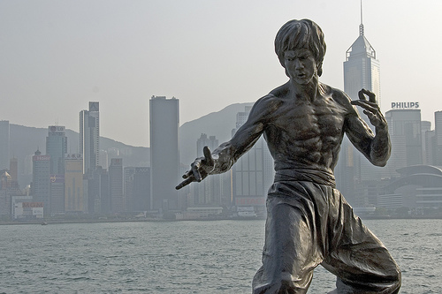
Any Questions?

