Slide 1
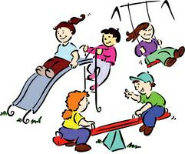
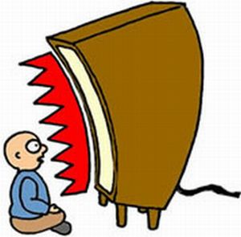
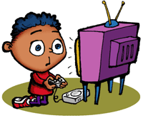
When you were a kid, how much of your time was spent outdoors, compared to your time spent indoors?

Slide 2
How Technology is Negatively Effecting our Children’s Health & Development
By: Theodore Beasley

Slide 3
Today, children's excessive use of technology opens them up to future health issues.

Slide 4
Overview
Excessive use of technology can be hazardous to a child’s health by:
Resulting in Obesity
Developing Insomnia
Inability to focus for a extended periods

Slide 5
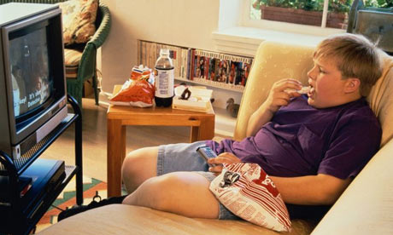
The child may develop obesity.
“The problem of childhood obesity in the United States has grown considerably in recent years. Between 16 and 33 percent of children and adolescents are obese.”
–American Academy of Child & Adolescent Psychiatry
“Many kids are spending less time exercising and more time in front of the TV, computer, or video-game console. From fast food to electronics, quick and easy is the reality for many people in the new millennium.” -Kidshealth.org
“All this gadgets just make them sit at one place, and when they tend to loose in any games or they are talking on cell phones their body craves for more food. They sit at one place and they keep on eating.” –healthandsoul.com

Slide 6
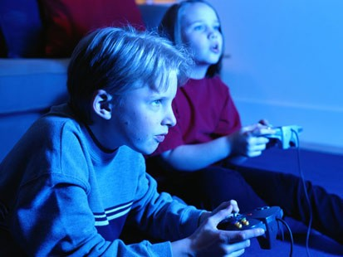
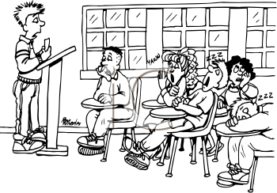
Developing Insomnia
“Results indicate that children who slept less consumed more caffeine and had more hours of screen time (use of television, Internet, computer and video games).” –esciencenews.com
“ A new study shows that the bright light of a computer screen may alter the body's biological clock and suppress the natural production of melatonin that's critical to the normal sleep-wake cycle.” –WebMD.com

Slide 7
Inability to Focus
“So increased screen time may be a consequence of A.D.H.D., but some researchers fear it may be a cause, as well. Some studies have found that children who spend more time in front of the screen are more likely to develop attention problems later on.”
-Perri Klass M.D., New York Times
“The kind of concentration that children bring to video games and television is not the kind they need to thrive in school or elsewhere in real life.”
-Dr. Christopher Lucas, associate professor of child psychiatry at New York University School of Medicine.

Slide 8
Conclusion
In order to ensure the proper health and development of children, their use of technology should be at a reasonable level. By doing that, the child’s chance of becoming obese, developing insomnia or acquiring a attention disorder will be lowered.
“Everything in moderation, including moderation.” – Oscar Wilde

Slide 9
References
"Obesity In Children And Teens." American Academy of Child & Adolescent Psychiatry. May 2008. Web. 06 Nov. 2011. <http://www.aacap.org/cs/root/facts_for_families/obesity_in_children_and_teens>.
"Overweight and Obesity." KidsHealth - the Web's Most Visited Site about Children's Health. Web. 06 Nov. 2011. <http://kidshealth.org/parent/general/body/overweight_obesity.html>.
"Adolescent Obesity Linked to Reduced Sleep Caused by Technology Use and Caffeine | E! Science News." E! Science News | Latest Science News Articles. 8 June 2009. Web. 06 Nov. 2011. <http://esciencenews.com/articles/2009/06/09/adolescent.obesity.linked.reduced.sleep.caused.technology.use.and.caffeine>.
"Nighttime Computer Users May Lose Sleep." WebMD - Better Information. Better Health. 19 June 2003. Web. 06 Nov. 2011.
Klass, Perri. "Fixated by Screens, but Seemingly Nothing Else." The New York Times. 9 May 2011. Web. 6 Nov. 2011.
Question20mark20pic1. Digital image. Youngster.files.wordpress.com. Web. 6 Nov. 2011.

Slide 10
References (Cont.)
How-Watching-TV-and-Adult-Media-Affects-Children-039-s-Health-2. Digital image. Http://i1-news.softpedia-static.com. Web. 6 Nov. 2011.
Ar122221681710142.jpg. Digital image. Http://charlottesvillerealestatetalk.com. Web. 6 Nov. 2011.
obese-television.jpg. Digital image. Http://cdn2.mixrmedia.com. Web. 6 Nov. 2011.
Kids-playing-video-games 042710.jpg. Digital image. Http://www.psychologytoday.com. Web. 6 Nov. 2011.
Snoozin2.gif. Digital image. Http://tneufeld.wikis.hsd.ca. Web. 6 Nov. 2011.
School_4_tnb.png. Digital image. Http://www.clipartoday.com. Web. 6 Nov. 2011.

Slide 11
Any Questions

